Slide 1
How to approach: CODE BLUE RAPID RESPONSE
Brian Locke
Pulm / CC Fellow
Notes:
Updates: https://onepagericu.com/running-a-code and https://podcasts.apple.com/us/podcast/critical-care-scenarios/id1491559787?i=1000597529478

Slide 2

What makes codes/RRTs stressful
Notes:
Absolutely normal to be freaked out about doing it. Why? (What is so scary about it).
codes: often, someone is dying in a violent way
Weird level of detachment required to function; yet engagement is required after
Variable comfortableness with taking control of the situation: are you prone to being more avoidant?
You are on display – there is often not someone to stop you from making the wrong call. You can help this by knowing your stuff and utilizing your resources.
there can be a power dynamic between the resident and either the primary team (if they are there) or the charge RNs/code teams (who have more experience that we do). I will give you hints to navigate these

Slide 3
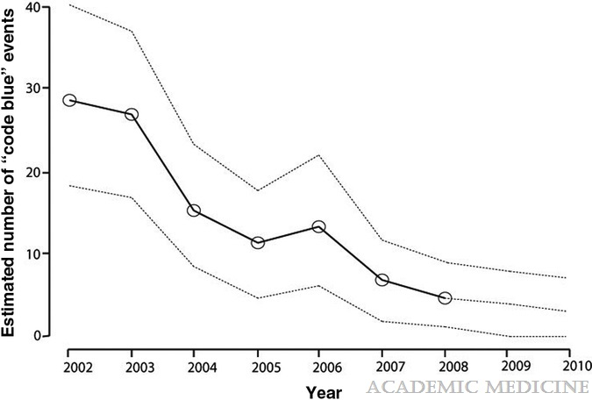
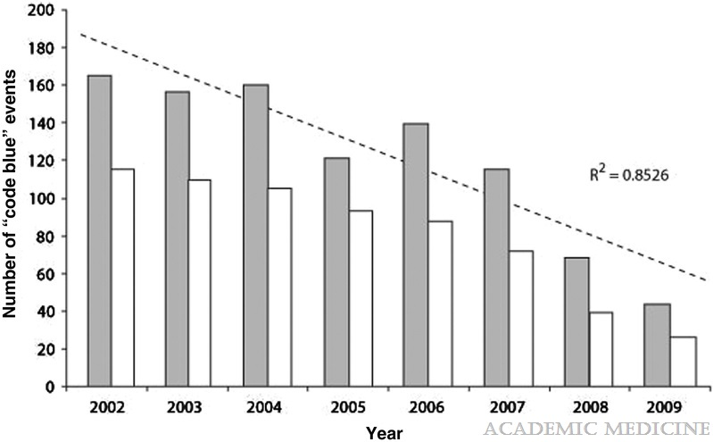
Code Blue: Less Common
Academic Medicine86(6):726-730, June 2011.
Notes:
COVID was a blip; how many codes have you been to?
Stochastic modeling of code blue frequency and resident call schedules predicting probable number of code blue events for a typical first-year resident (based on known event rates and annual resident code team obligations). Bold line is the predicted average, and dotted lines represent the predicted range.
Hypotheses – many less codes due to the course and outcomes associated with COVID related codes and changes to the makeup of the code teams.
Possibly more rapid responses?
how many have been at a code this year? 1? 5? (There are a lot less, I think, because of COVID. And there was a period when the codes that did occur didn’t include medicine residents/interns)
-how many *** rapid response?
-how many have run a rapid response or code? How many have been involved in the decision-making

Slide 4
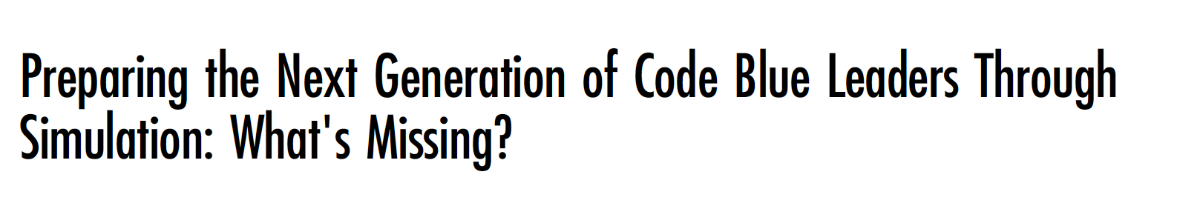
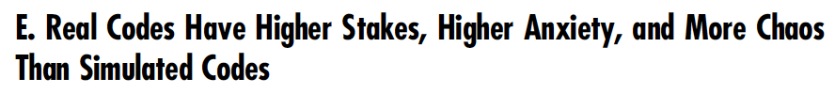
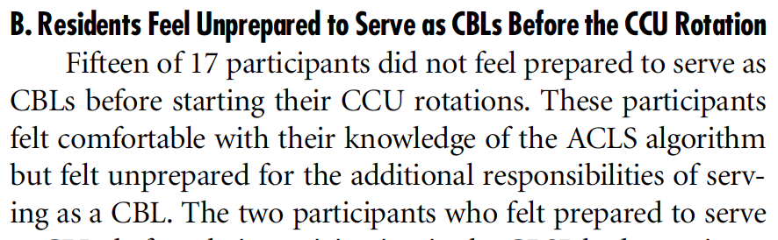

Slide 5
Learning objectives:
You should:
Have phrases ready to help avoid some of the major team-dynamic problems that occur in RRTs / Codes
Understand the key components to creating a productive team dynamic during a code
Understand the key decisions that need to be made in a RRT or code
Consider a few scenarios you may have seen (or will see)
Notes:
Think of a code that went really well
Think of one that didn’t
Keep those in mind as we talk.

Slide 6
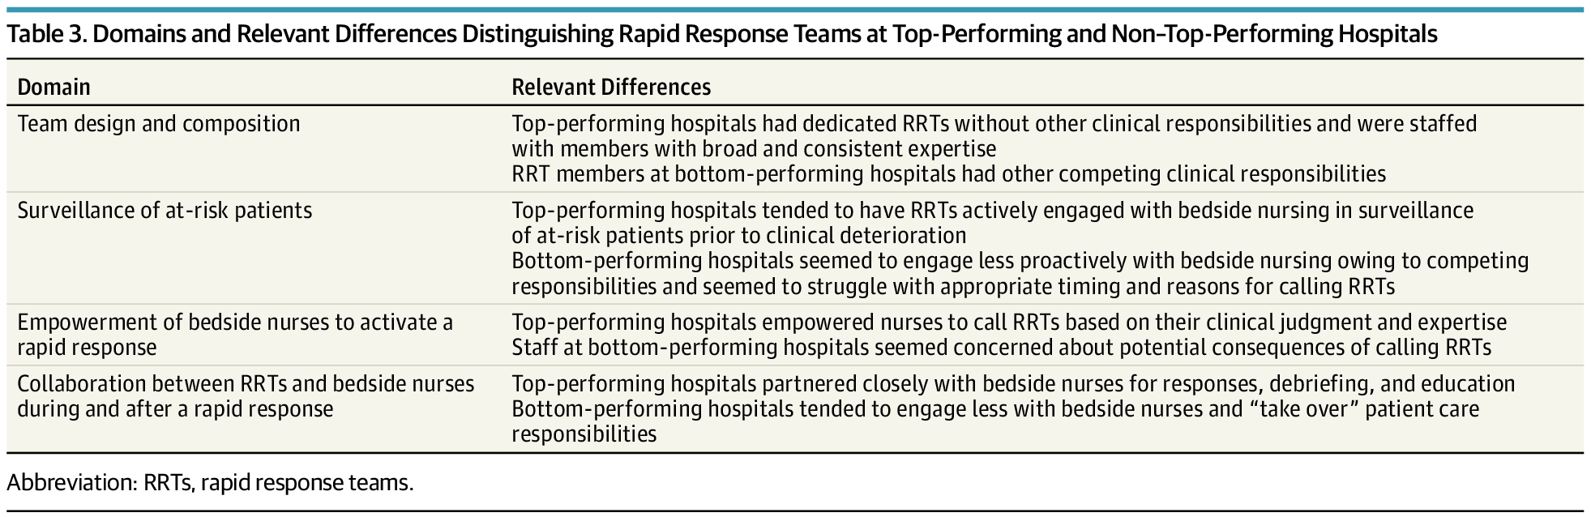
What’s the big picture?
Hello, nice to meet you. Let’s code
doi:10.1001/jamainternmed.2019.2420
Notes:
you're going to go in to a room with ~10+ other people who, in general, you don't know and who don't know you.
They don't know if you're a genius or an idiot (though they do know you're not super experienced).
You have to assemble into a team to adapt to the constraints of the situation
Everyone is stressed, it is an emergency.

Slide 7
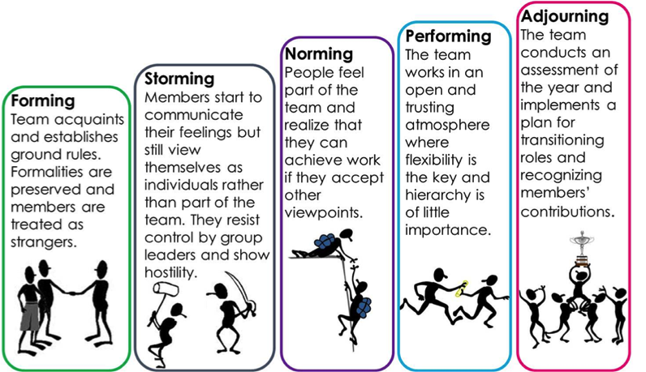
Team Dynamics
Tuckman’s stages of group development (1965)
Notes:
Describes code team dynamics well: you’ve likely never worked with these people before, and have to get to the far right stages FAST
These same tasks have to happen, even if there are rules to help move things forward.

Slide 8
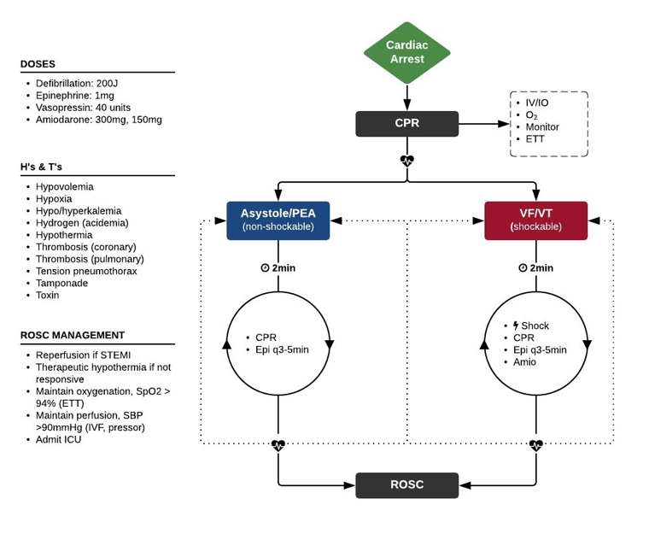
ACLS isn’t hard… with some help from your friends
Notes:
This is almost always where teams struggle
ACLS algorithms:
not that complex
there are cards in the code carts
there will be ~5+ other people there who know ACLS like the back of their hand*
RRTs can be medical complex, but the key decisions are simple
Sociology lens. Why? The medicine isn't that hard (not that easy, either) - but a lecture isn't the right place to review it.

Slide 9
ACLS isn’t hard… with some help from your friends
Notes:
This is almost always where teams struggle

Slide 10
You want to immediately establish…
Collaboration / Trust
Lower the power distance
Proper tone
Are you the point person (in practice)?
Are you running the code/rapid in theory?
Notes:
You can’t really move up the hierarchy until you hit the lower stages
First impressions matter. It is very hard to re-assert yourself as a code leader if you've been there. Your goal within the first 10 seconds of walking in to that room is to establish the above things
Are you running this code/rapid? (or not)
Signal to everyone that you will be the point person
Signal to everyone that you want their input, and they are valued for what they might notice.
Set the proper tone (calm, collected, and in control)

Slide 11

Step 1: Are you running this code or not?
"I'm Brian Locke, the resident on the the Code team/RRT. Is anyone running this code?"
“OK, I’m running this code”
“Can I take over?"
Notes:
How do you respond?
If someone IS already running it – that’s OK. They often want to hand over. If they don’t, make yourself useful.
You just need to commit to saying this. Loudly, right when you enter the door.

Slide 12
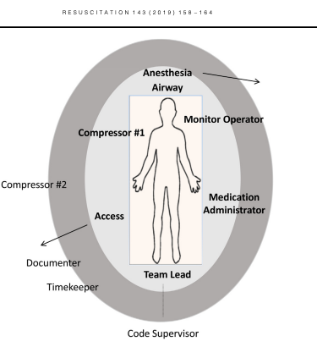
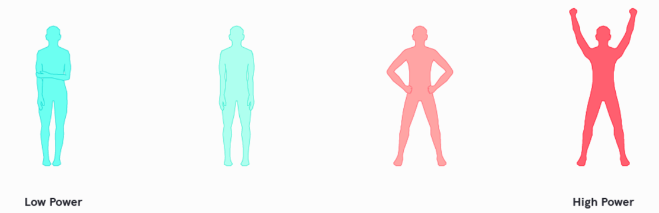
Step 2. Signal that you will be the point person
https://doi.org/10.1016/j.resuscitation.2020.11.018
Notes:
I recommend foot over groin because it’s too tempting to do things at the groin
Park yourself at the foot of the bed (do NOT do any tasks unless there are <4 people present)
feet in a power pose - go wonder woman, not full arms iup
+/-ACLS card in front of you.
Direct traffic.
If someone asks for a task you agree with, say "Yes, <repeat it>" - all commands are coming from you.

Slide 13
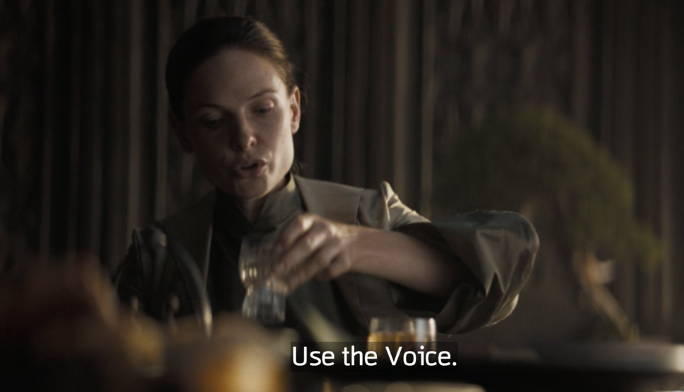
Step 3: Set the proper tone - constructive
Calm, collected, and in control
Modulate your voice; no yelling
Coach, don’t reprimand.
Give encouragement.
Notes:
You can call for quiet to lower the noise level. Have folks step out if too crowded – you control the environment
Bene Gesserrit skill- with the right tone you can control people; like good sci-fi, it’s compelling because its true

Slide 14
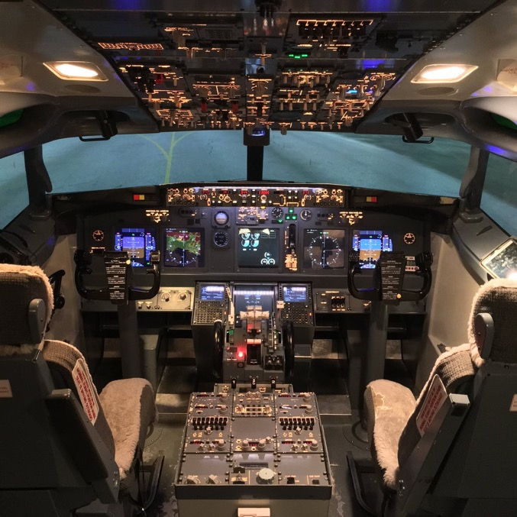
Step 4: Lower the Power Distance
Lead like a president not like a monarch.
The first time anyone makes any suggestion that's not ludicrous address them and say: "great point/idea/catch .."
“Thinking out loud …”
Notes:
Higher power distance (hierarchical social structure) = More plane crashes. Same probably true for this
What is the point of the bottom two?
Think of motivational interviewing with a patient.. You NEVER want to argue. You want to direct. Do the same thing here. You are directing a competent team of professionals who could do a pretty good job running a code on their own (they do in lots of places). Don’t break the machine – you want to productively guide it.

Slide 15
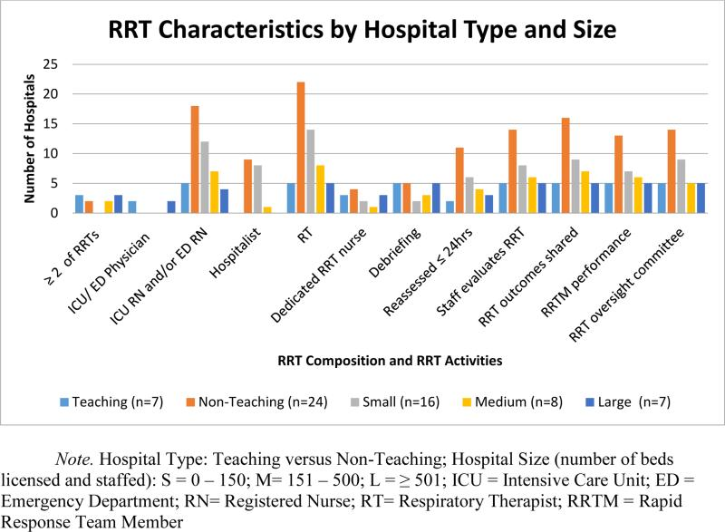
No MD or Resident in many places
The code could run without us– our role is to *add value*
This is very different from our simulations
PMID: 25977203
Notes:
You have much more cumulative experience there - the pharmacists all know all the medication doses off the top of their heads. The charge nurses know the delegation of roles and troubleshoot equipment. RT will generally just handle the airway.
How many of you did mock codes in medical school? I think we still do some in residency? Unlike those – RNs are RNs (and the best of them), RTs are RTs, and pharmacists are pharmacists. You can focus on the big picture.

Slide 16
Intermission
Codes / RRTs are stressful for many reasons.
The most common way for them to go wrong are problems with social dynamics, not with medical decision making
To avoid the biggest pitfalls:
Establish who is the leader, first by designation then by action
Signal that you want people’s input
Direct the group like a coach, don’t rule like a queen/king
*Use your social capital on things that matter

Slide 17
You want to immediately establish…
Where to use your social capital?
Collaboration / Trust
Are you open to input?
Proper tone
Are you the point person (in practice)?
Are you running the code/rapid in theory?
Notes:
You’ll only have so much credibility.
Jim Orme could walk into a room and tell people to quack like a duck and they would – us; it’s more limited.

Slide 18
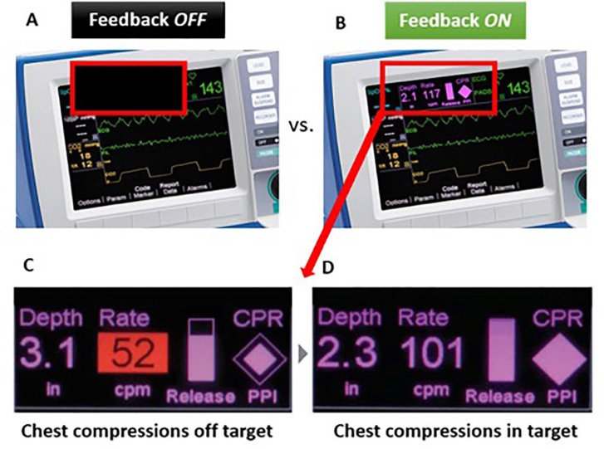
What is the big picture?
In a Code:
If they don’t have a pulse, someone is compressing the chest with high quality CPR. NO significant breaks.
Minimize pauses to necessary position changes, pulse checks, and a little wiggle room to the Lucas or intubation (but only a little)
shock them if they have a shockable rhythm
Notes:
Don’t try to diagnose lupus in a code.
The rest is not important (people will be fired up about all sorts of things, but they don't matter). It’s a bonus if you figure out why they coded, but it’s a small, small minority where the etiology is not blindingly obvious but is also easily reversible.

Slide 19
What is the big picture?
Rapid Response:
Is this really a code blue?
will it be in the next 10 minutes? Do I need airway people here?
Do they need to be in an ICU?
eyeball the patient, ask orientation questions, 1 set of vitals, what led to the RRT. 10 minutes, maximum
Yes: Do we need to do anything to stabilize them before they go to the ICU?
No: What immediate workup or stabilization do they need? Hand off to primary team
Notes:
With the possible exception of an ABG (and I’d argue even not that, usually), do not wait on labs to tell you if a patient needs to go to an ICU
if nursing cares are prohibitively intensive

Slide 20
Scenarios:
What have you seen?
Notes:
Your upper levels are not here
Don’t name names
But you all have problem seen pitfalls or pearls – or situations you keep wondering about?
I have several scenarios, but situations y’all worry about would be best to discuss.

Slide 21
Scenarios:
Patient is 90 years old, has a single BP of 75/60. Is mentating ok, making good urine, lactate is normal. RRT is called. You see that the blood pressure cuff is clearly too large. You have them swap it out and the measured blood pressure is now normal without intervention.
How do you address the RN that called the RRT?

Slide 22
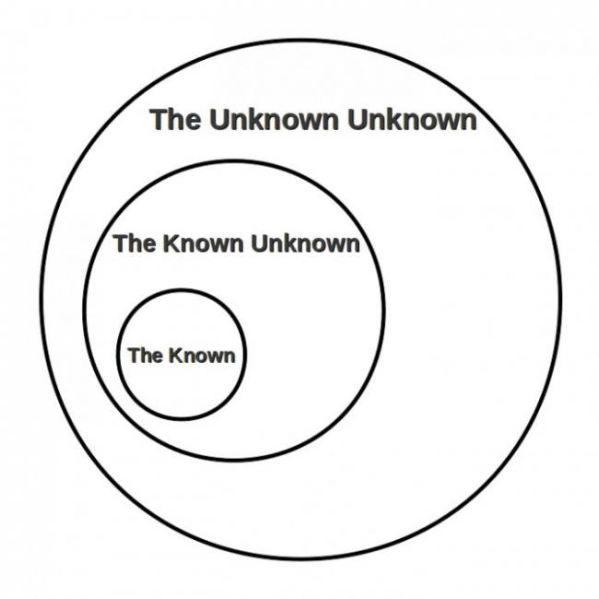
Scenarios
Try your best not to implicitly snark people for ‘over-reacting’. Why?
People at lower levels of training are going to be less accurate at identifying big problems.
To avoid errors of not calling a code/RRT, we need to tolerate errors of calling excessive codes/RRTs
Notes:
Hospitals vary in that some allow only RNs, some allow RNs and staff. Some allow families to call RRTs
Widely variable level of experience – if you think how often on specialty rotations “I don’t really understand this but I’m worried I’m missing something”… Imagine a new nurse?

Slide 23
Scenarios:
A patient with ESRD is in dialysis and codes. Staff seems them slump over and CPR is started immediately (<1 minute).
During the 1st round of CPR the patient appears to try to push themselves up but remains unresponsive during the ½ second the compressor takes to regain composure.
“Should we stop compressions?”

Slide 24
Scenarios:
A patient with ESRD is in dialysis and codes. Staff seems them slump over and CPR is started immediately (<1 minute).
During the 1st round of CPR the patient appears to try to push themselves up but remains unresponsive during the ½ second the compressor takes to regain composure.
“Should we stop compressions?”
Perfusion =/= ROSC

Slide 25
Scenarios:
A patient with ESRD is in dialysis and codes. Staff seems them slump over and CPR is started immediately (<1 minute).
During the 1st round of CPR the patient appears to try to push themselves up but remains unresponsive during the ½ second the compressor takes to regain composure.
CPR continues as per ACLS for 30 minutes. You sense murmurs about when you should ”call the code” …

Slide 26

How long should resuscitation efforts go?
“A cut-off time of 15 min, 20 min and 60 min, respectively, captures 90%, 95% and 99% of the 30-day survivors.” PMID: 30138650
Unlike OHCA, IHCA brain injury is not as closely correlated with CPR time.
Should depend more on pre-arrest status
Notes:
You will never know if you stop to early

Slide 27
Scenarios:
A patient with ESRD is in dialysis and codes. Staff seems them slump over and CPR is started immediately (<1 minute).
During the 1st round of CPR the patient appears to try to push themselves up but remains unresponsive during the ½ second the compressor takes to regain composure.
CPR continues as per ACLS for 30 minutes. You decide this patient is unlikely to recover. How do you stop the code?

Slide 28
Scenarios:
A patient with ESRD is in dialysis and codes. Staff seems them slump over and CPR is started immediately (<1 minute).
During the 1st round of CPR the patient appears to try to push themselves up but remains unresponsive during the ½ second the compressor takes to regain composure.
CPR continues as per ACLS for 30 minutes. You decide this patient is unlikely to recover. How do you stop the code?

Slide 29
How I do it:
Summarize what you have done
Voice any uncertainties
Ask if anyone has any ideas
Pause
I think we should stop
Does anyone have any objections? vs We have done everything we could
Stop compressions and stop ventilation
Then what?

Slide 30
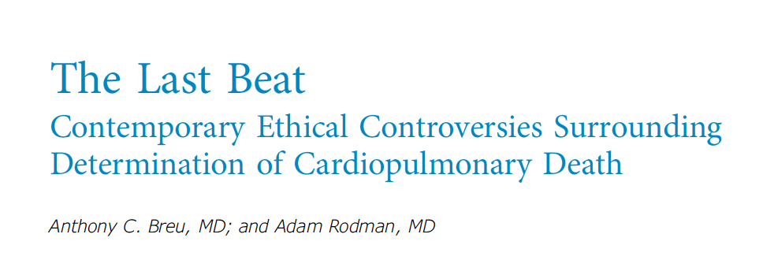
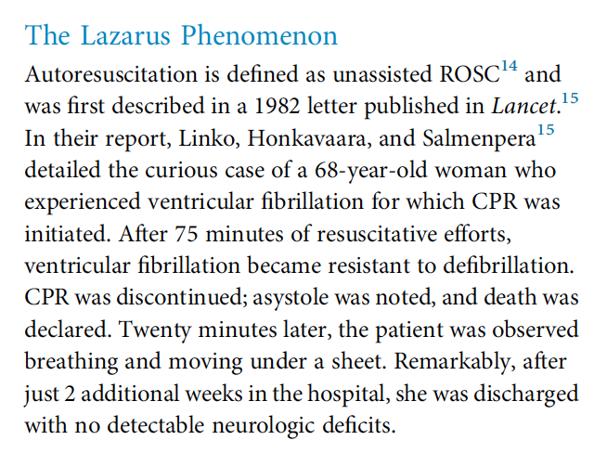

When to declare death?
Longest reported time between asystole & flat MAP and auto-ROSC? 4:20
“The International Guidelines for Determination of Death at 2 to 5 minutes of observation”
Notes:
Theory – autopeep from overly vigorous bagging leads to increased intrathoracic pressure, which resolves with cessation.

Slide 31
Debrief
Thank you everyone for their efforts.
“We’ll debrief in 5 (or 15) minutes at the nursing station”
How do you run the debrief? (you run the debrief)
Notes:
Really sucks, especially in the case where it seemed preventable.

Slide 32
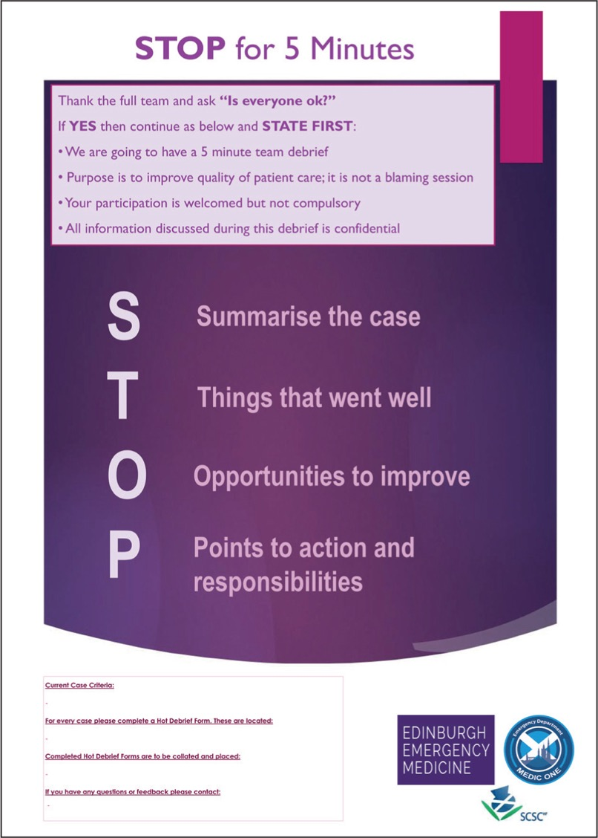
Debrief
Goals:
Discuss events leading to the event
Recognizing things that went well and didn’t go well to improve in the future
Identify systems issues
Notes:
Really sucks, especially in the case where it seemed preventable.

Slide 33

Debrief: Hot vs Cold
Goals:
Discuss events leading to the event
Recognizing things that went well and didn’t go well to improve in the future
Identify systems issues
Not debriefing normalizes a horrible situation
Odds are it was either:
Someone’s first code
Someone feels responsible
Recognize the gravity of what just happened.
Notes:
Flexibility with respect to how hot vs cold the situation is

Slide 34
Scenarios:
Code Blue.
Pulse check
What do you do?

Slide 35

Scenarios
Notes:
Do not miss fine V Fib.
This is harder than you think
Have someone bring the tele strip to all RRTs or code that occur when someone is monitored
People who code on monitored units generally don’t go straight to Asystole
IF IN DOUBT, JUST SHOCK

Slide 36
Scenarios:
A patient is in profound shock from GI bleeding. RRT called due to MEWS score of 8. There is ongoing bleeding. Transfer to ICU is initiated.
Initial VS are HR 150 and BP 70/30. Then, HR 160 and BP 60/30. Then your colleague can’t feel the femoral pulse so you start compression. After 1L of fluid and 1 prbc unit is pressured bagged in the patient regains a pulse.
When you arrive at the ICU – the MICU fellow gives you snark “was this really an arrest”? What do you think?
Notes:
Or same version of this in every ED syncope patient

Slide 37
Mechanisms of PEA
Electromechanical Dissociation
Think of what would happen if the heart muscles, but not the nerves, run out of ATP (or O2, or any other reagent)
The extreme of shock
BY DEFINITION: this is shock so severe you can’t palpate a pulse. No BP criteria is needed
Beware of an art line telling you they have a BP of 40/20. If you can’t feel the pulse, that is not sufficient to perfuse and you should start compressions.
Notes:
Or same version of this in every ED syncope patient
Imagine you get worse and worse

Slide 38
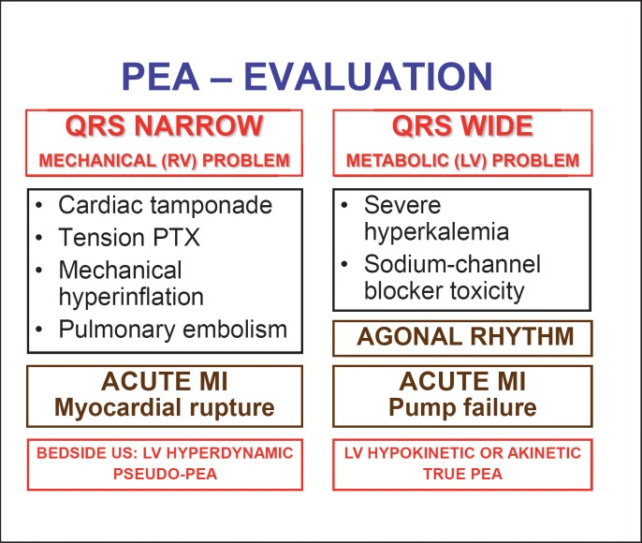
Forget the H’s and T’s
Littman Approach
Left column (narrow QRS) requires a mechanical fix
Right column requires a medical fix
doi: 10.1159/000354195
Notes:
Literally every abnormal vital sign or lab value starts with H

Slide 39
TAKE HOME POINTS
“I’m <Name>, the resident on the code team. Who is running this code?” “OK, I’m running this code” or ”Can I take over?”
Stand at the foot of the bed. Don’t move. Don’t do tasks.
Set the tone; give encouragement to sharing information/suggestions
Keep the big picture in mind and use your social capital there:
Code: High quality compressions; shock if shockable
RRT: Is this a code? Does this patient need to go to the ICU?

Slide 40
Questions?
Brian.locke@hsc.Utah.edu

